Slide 1
INTERFACE AND BATCH JOBS

Slide 2
MEET OUR TEAM
CHRISTIAN SIERRA-PEREZ
EMILY
BUKH
DANIELLE
PETRUNTI
SAMI
ISPAHANI
RAYMOND
LI

Slide 3
Key Ideas - Interface and Batch Jobs
01
02
03
04
Configuration
Monitoring
How are systems are configured?
How do paths of data move within
systems?
What is the frequency of Batch Jobs?
How are batch jobs monitored to check for inconsistencies or failures?
Appropriate Access
Encryption
How is authorization granted to access batch jobs?
How is encrypted data validated with the use of current regulations and laws?

Slide 4
Interface and Batch Jobs Narrative
INCOMPLETE SLIDE - Delete when complete
New User/Modify Access:
Currently there is a lack of restrictions in accessing information through the Oracle interface from inappropriate personnel
Furthermore, there is no process in place to modify and limit access by team leads or any other user
Periodic User Access Review:
At present, there is no process in place such as a logging system to see which users are accessing what information
With no logging system, periodically reviewing which user has appropriate access is purely based on their job title

Slide 5
Interface and Batch Jobs Narrative
INCOMPLETE SLIDE - Delete when complete
Segregation of Duties:
Within the organization, there are roles such as facilities manager, IT analyst, secretary and IT director who all are given access to the Oracle Interface
Password Configuration:
Currently the company does not have any special regulations for when employees are creating passwords
Furthermore, passwords are not encrypted which creates an issue

Slide 6
1
5
Obtain understanding of the batch jobs
Verify that interfaces and batch jobs are secured
TEST PLAN
2
4
Confirm that the batch jobs are configured properly
Verify that user access are correct and updated often
3
Verify that the batch jobs are being monitored routinely, not only when they fail

Slide 7
Audit Program Guide
Control Activity
Control Objective
In depth Audit Program Guide
Data integrity and security is maintained for key inferences and batch jobs
Oracle job scheduler
Sent to Merkle and weekly to RuffaloCODY
Email alert sent out when or if batch jobs fails
Failure is investigated
To gain access, users must make requests to the Senior Director
Only people from the interface can gain access
No encryption is being used for batch jobs
Risk
Systems data may not be accurate, completed or authorized as they entered, processed or reported

Slide 8
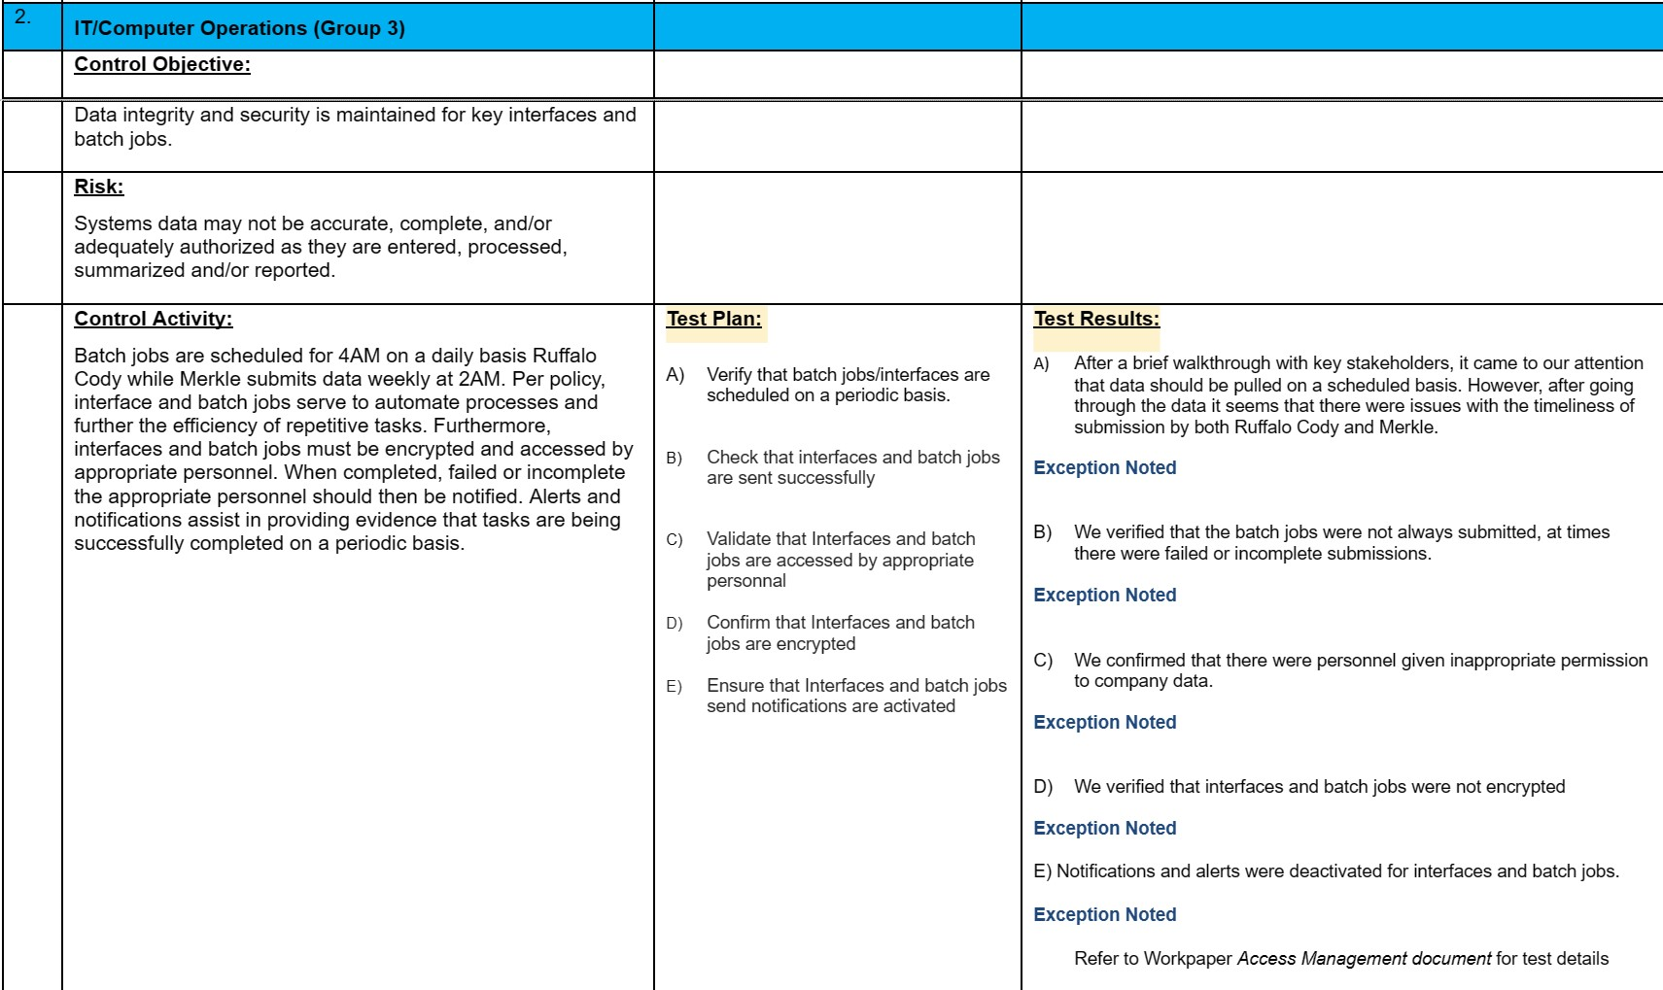
Interface And Batch Jobs IT Audit Program Guide Template

Slide 9
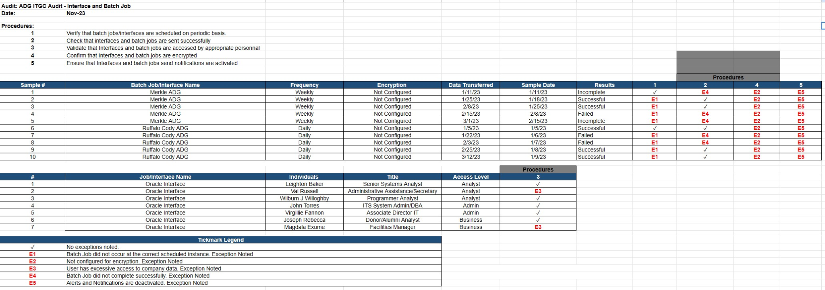
Interface And Batch Jobs Test Sheets and Data Evidence

Slide 10
Batch Job Procedure
Verify that they are scheduled on a periodic basis
Ensure they are properly encrypted
Confirm access availability and update regularly
1
3
5
Validate that they are monitored routinely
Ensure completion and success
2
4

Slide 11
Audit Report
Objective: Our goal is to evaluate the Interfaces and Batch Jobs for the Alumni and Donor System.
SCOPE:
Check that interfaces and batch jobs are sent successfully
Validate that Interfaces and batch jobs are accessed by appropriate personnel
Ensure that Interfaces and batch jobs send notifications are activated
Verify that batch jobs
and interfaces are scheduled on periodic
basis
Confirm that Interfaces and batch jobs are encrypted
Notes:
Danielle’s Slide

Slide 12
Distribution
Audit Team
Distribution and The Audit Team
Leighton Barker
Val Russell
Wilburn J Wiloughby
John Torres
Virgilie Fannon
Joseph Rebecca
Magdala Exume
Emily Bukh
Christian SIerra-Perez
Danielle Petrunti
Raymond Li
Sami Ispahani
Notes:
Danielle’s Slide

Slide 13
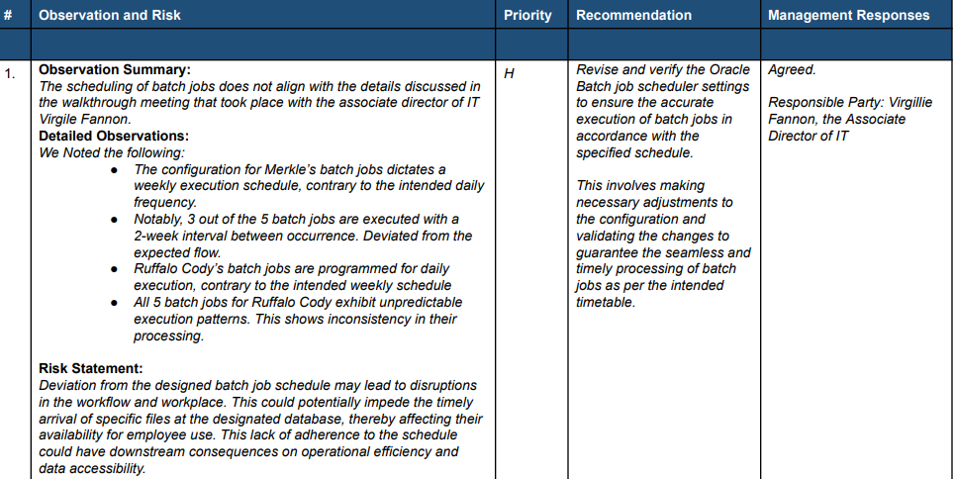
Detailed Observations, Recommendations and Management Responses
Notes:
Danielle’s Slide

Slide 14
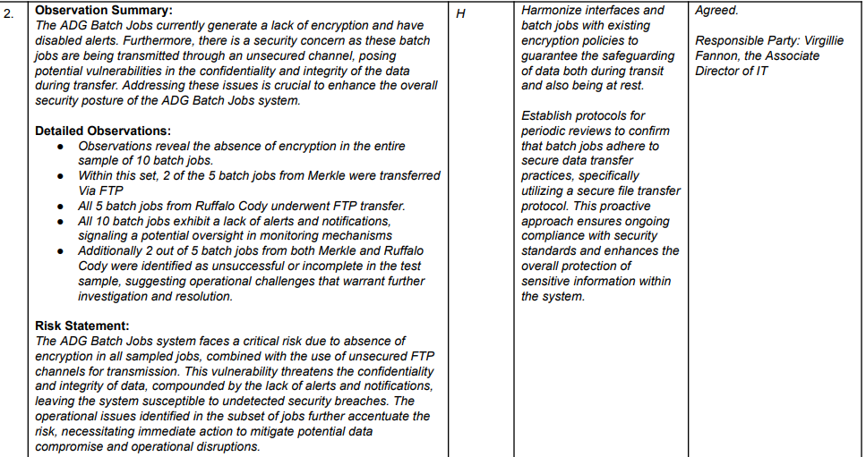
Detailed Observations, Recommendations and Management Responses

Slide 15
Thank you!

